Slide 1
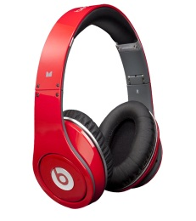
ATTENTION Year 11 Linguists!
You will shortly have your speaking assessment worth an important 15% of your final GCSE mark.
You receive the questions in advance of this assessment and so full and thorough preparation is the key to success.
Here are some tips and certain ways to improve your performance and grade
BUDDY UP. You can practise with one another. Choose a buddy (or a few) and practise with each other, taking it turn about. Practice makes perfect!
EFFECTIVELY USE YOUR TIME – Got five minutes to spare before tutor time or at break? Then practise with your buddy / group or alone. Spare minutes at home? Get a sibling to quiz you.
RECORD IT! Why not record your oral to practise and memorise on the bus or walk home. Use Windows Sound Recorder / Garageband / Audacity / Any Mobile phone recording/sound app / Dictaphone / www.vocaroo.com
LISTEN ON THE BUS Use www.zamzar.com for file conversion to transfer to ipod/mp3 player/phone to listen to when you would normally listen to music
DIVIDE IT UP – too much info? Divide it into manageable chunks on flashcards or post-it notes. Colour code your work or create a text with gradually increasing number of gaps in your text.
CHECK PRONUNCIATION of words you don’t know how to say: http://www.acapela-group.com/text-to-speech-interactive-demo.html (just google “acapela text to speech” to find it) OR http://www.naturalreaders.com
USE FACILITIES the school offers you. ICT facilities are available after school in B236. This is also a space that you can come and practice with your buddy.
ASK FOR HELP Any queries, ask your language teacher. For technical queries, see Ms Grindley in 1516 or
an IT technician.

